Slide 1
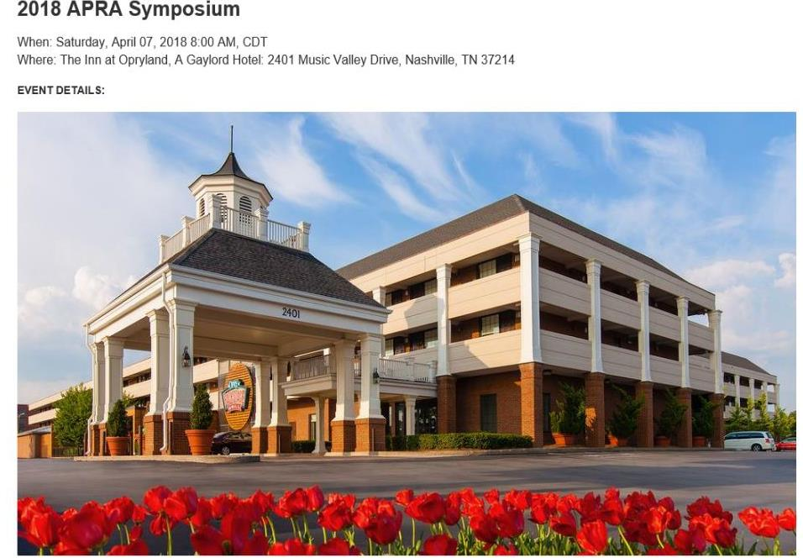

Slide 2
The Golf Course –
A Very Depreciable Asset
April 7, 2018
J.J. Keegan, Managing Principal

Slide 4
Today’s Game Plan
Asset Reserve Studies
The Golf Industry from 30,000 feet
Heuristics
Who?
A Decision?
Seven Steps
Three Facts

Slide 5
J. J. Keegan: My Passion
CREATE VALUE FOR GOLFERS
ON A FOUNDATION THAT ENHANCEs THE FINANCIAL PERFORMANCE OF A GOLF COURSE.
Golf Strategist – 13 years including 7 months as GM operating golf course for client
2016/17/18 Client Engagements:
Municipalities - Cities of Albuquerque, Arlington, Baltimore, Brookings, Enid, Gardner, Kent, Killeen, Lancaster, Lexington, Mecklenburg, County, Minneapolis Park Board, Round Rock, New Braunfels, Palo Alto, South Bend, Spokane, Superior
Daily Fee – Arroyo Trabuco, Cutter Creek, Cypresswood, Plum Creek, Oconee Country Club, River Run, Silver Creek, San Vicente, Sterling Hills, Sun City - Summerlin, Timberline
Private Clubs – Canyon Lake, Craigowan, Eagle’s Bluff, Green Meadow, Ravenna
Resorts – Kokanee Springs, Prairie Club
Webinar Series: 20 golf course management teams operating 60 golf courses through a strategic planning process including: Baltimore, Bloomington, Brooklyn Park, Charlotte, Cedar Rapids, Columbus, Crystal Mountain Resort, Fort Worth, Oak Creek/Pelican Hills, Pine Meadow, San Antonio, Salt Lake City, Virginia Beach, participated.
CEO - Fairway Systems: Golf Management Software – 1989 to 2005 (450 golf courses, 7 countries)
Memberships: GCSAA. Formerly member of NGF, NGCOA and CMAA.
Speaker: NGCOA, NGCOA – Canada, Michigan Golf Course Owners, New England Golf Course Owners, Golf Course Superintendents Association, NRPA, Golf Course Builders, PGA Sections including Wisconsin
Professor: Clemson University, Keiser University – College of Golf, College, Holland College, Golf Academy, Professional Golfers Career College, University of Incarnate Word
Golf Magazine Panelist: Visited 4,000+ golf courses in 49 of the 203 countries, played 1,750+ of the world’s 34,011 courses
Education & Licensing: BBA – TCU, MBA – University of Michigan, CPA – Inactive, Caddie Scholar

Slide 6
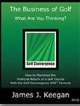
The Business of Golf – Series
6,548 Copies Sold – 16 Countries – 15 Colleges’ PGM Programs
Published August 17, 2016: 968 Copies Sold

Slide 7
Fact 1

Slide 8
The Path Has Many Forks
Do Your Golf Course Have to Be Financial Self Sustaining?
Yes
No
Cash Flow
Cash Flow + Future Capital
Cash Flow
+ Future Capital + Debt

Slide 9
The Path Has Many Forks
Do Your Golf Course Have to Be Financial Self Sustaining?
Yes
No
Cash Flow
Cash Flow + Future Capital
Cash Flow
+ Future Capital + Debt

Slide 10
The basic business model for golf courses is flawed.
Only 60% can cover operational costs,
Less than 20% can cover capital costs
without assessment or borrowing.

Slide 11
Fact 2

Slide 12
The business skills
of the typical golf course employee
are below average
resulting from lack of training and a poor attitude

Slide 13
Fact 3

Slide 14
The politics of “government” contribute to and emasculate the ability of a golf course to be managed as a professional business.

Slide 15
A Tough Task: Aligning Common Interests
Public Facility
Facility
Golfers –
Pay Fair Value
City Council or Owner –
Invest to Avoid Continuing Subsidy
Taxpayers –
Collegial Support
Course Management and Staff –
Renovate and Efficiently Manage

Slide 16
A Tough Task: Self Interest vs. Enterprise Health
Golfers:
$96,000
43.1 years
88.5% Male
Low Prices
Resource Consumptive
City Council
Self Sustaining
Public:
No Support
Staff:
Capital Starved
Work Hours
Low Morale
Notes:
JJ Keegan

Slide 17
A Tough Task: Aligning Common Interests
Private Club
Board of Directors:
Create Culture, Governance and Fiscal Accountability
Members:
Value Based Leisure
Employees:
Resources to Efficiently Manage

Slide 19
A Strategic Plan
In a well-managed operation, every operational decision can be traced up to the tactical plan and up to the strategic vision.
Why
Strategic
Vision
How
Tactical (Functional)
Operational (Execution)
What

Slide 20
A Strategic Plan
Culture
Vision
History
Tradition
Governance
Asset Management
Financial Management
Golf Course
and Clubhouse
Human Resources
Club Events
Food and
Beverage
Banquets and Catering
Range,
And Lessons
Leadership: Management
and Training
Labor Staffing
and Scheduling
Brand:
Advertising and Marketing
Operations: Activities
Outside Tournaments
Operations: Management
Green Fees & Carts
Customer
Feedback
Notes:
JJ Keegan

Slide 21
GLMA
Technology
Facilities
Customers
Start
Finish
1
2
3
4
5
6
7
Weather
Impact
Financial
Metrics
Operations
Uncontrollable
Controllable

Slide 22
Dissertation Title
Empirical study of the effectiveness, reliability, relevancy, and development of a golf management system and tools designed to educate golf course managers towards completing strategic, tactical, and operational plans to improve the financial performance of golf facilities.

Slide 23
Heuristic (/hjʉˈrɪstɨk/; Greek: "Εὑρίσκω", "find" or "discover")
Refers to experience-based techniques for problem solving, learning, and discovery that find a solution which is not guaranteed to be optimal, but good enough for a given set of goals.
Where the exhaustive search is impractical, heuristic methods are used to speed up the process of finding a satisfactory solution via mental shortcuts to ease the cognitive load of making a decision.

Slide 25
Revenue at a Golf Course
Step 1: Highest Post Green Fee Rate X Number of Rounds
Step 2: Multiply Step 1 Result by 60%
Example: $45 * 30,000 rounds = $1,350,000 * 60% = $810,000
Represents revenue for green fees, season passes, carts

Slide 26
Maintenance Budget Determines Green Fee
Step 1: Maintenance Budget * .0001
Example: Average Municipal Budget $450,000
$450,000 * .0001 = $45 (Average Municipal Green Fee)

Slide 27
The Financial Success of a Golf Course
Is Predicated on these Numbers
Question | Your Answer
1. What is your PREDICTIVE INDEX Score
2. What is your MOSAIC Profile Rating
3. What is the number of Golfers Per 18 Holes Within 10 Mile?
4. What are current water and the associated electrical pumping costs?
5. What is the fringe benefits percentage in relationship to base pay?
6. How many hours are expended weekly in pro shop labor hours during prime season
7. Weekly Maintenance Labor Hours during Prime Season
8. Green Fee as a Percent of Annual Maintenance Budget
9. Unlimited Season Pass Rate: Green Fees Only
10. Number of Email Addresses in Customer Database
11. Outstanding Debt
11. Capital Reserverst

Slide 28
GLMA
Technology
Facilities
Customers
Start
Finish
1
2
3
4
5
6
7
Weather
Impact
Financial
Metrics
Operations
Uncontrollable
Controllable

Slide 29
5
The golf course is a living organism that requires constant capital reinvestment to maintain the customer value proposition to avoid the death spiral of a declining experience.

Slide 31
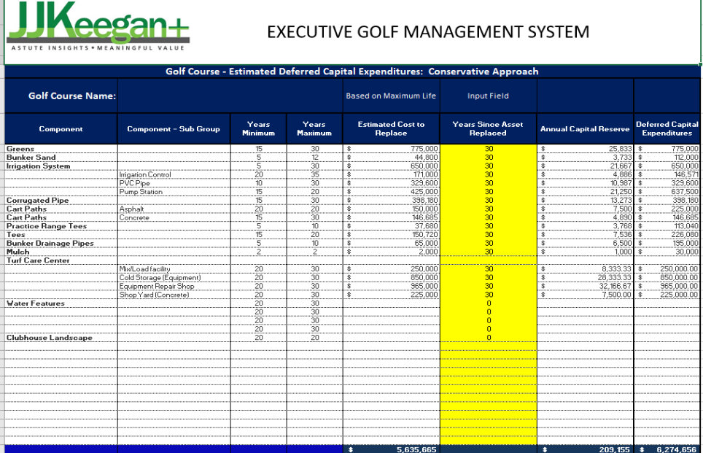

Slide 32
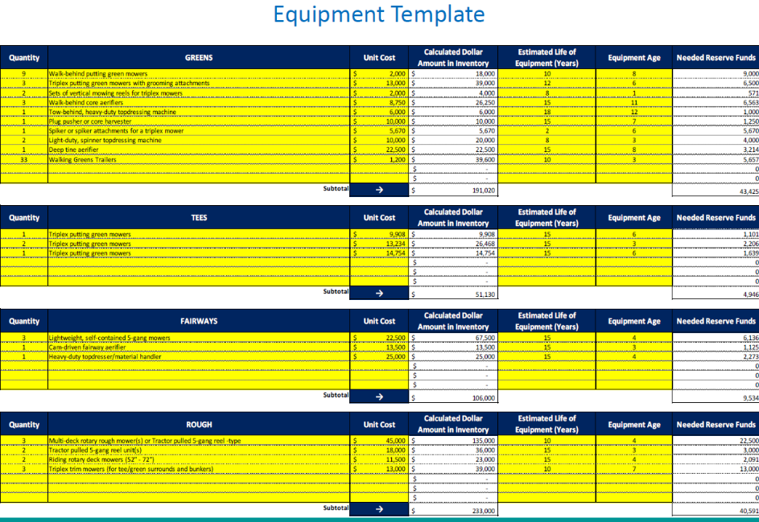

Slide 37
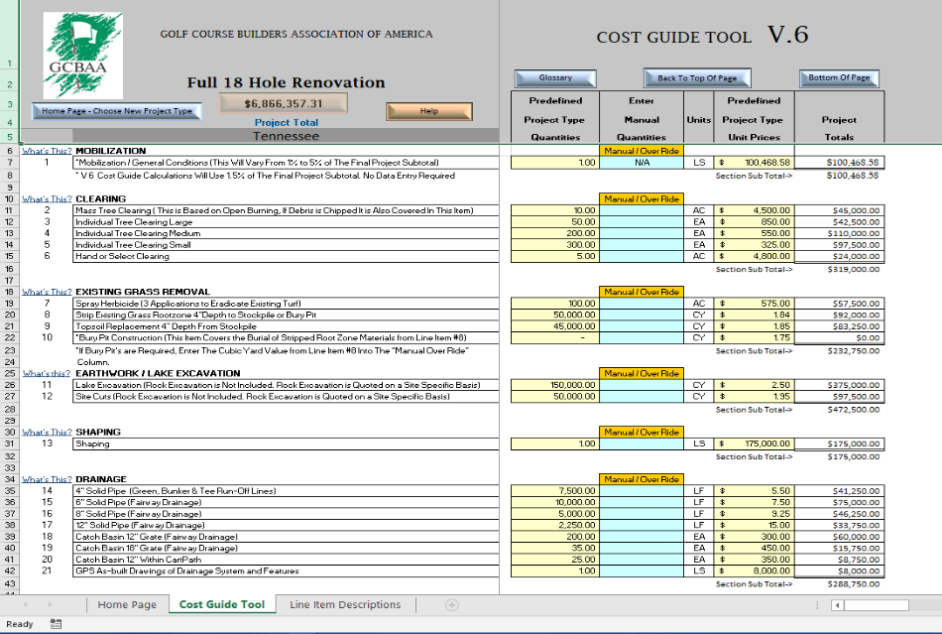

Slide 38
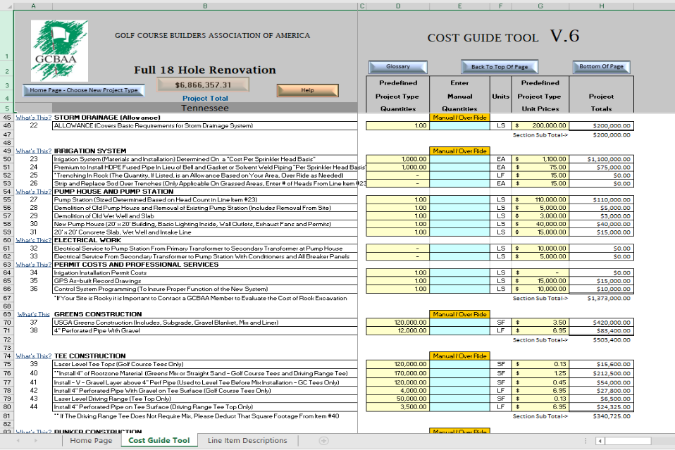

Slide 39
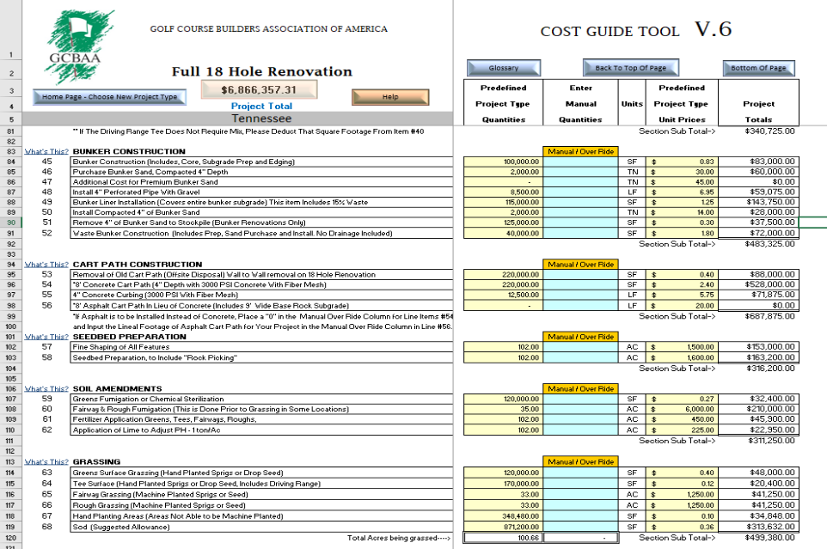

Slide 40
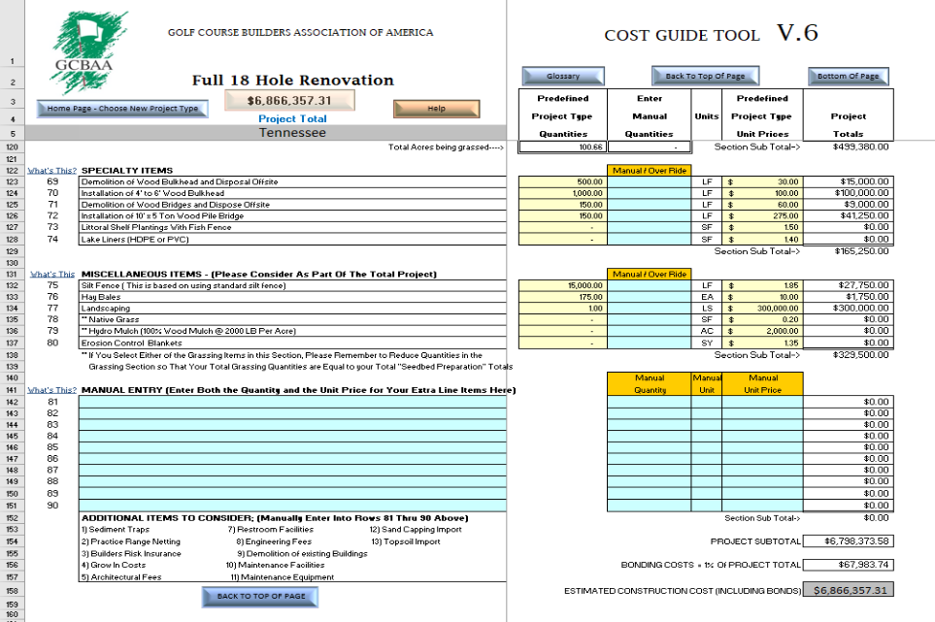

Slide 42
 | 2012 |  |  | 2015
 | All | Non-Private | Private | All | Non-Private | Private
Total | 651,392 | 458,071 | 848,951 | 697,000 | 487,000 | 940,000
Water | 16,499 | 12,484 | 20,390 | 22,800 | 17,400 | 28,600
Fuel | 289,174 | 22,260 | 33,876 | 29,200 | 22,900 | 36,200
Mowing/Cutivating Equipment | 37,644 | 25,335 | 50,649 | 31,300 | 25,700 | 37,700
Handheld Equipment | 3,066 | 1,702 | 4,419 | 2,410 | 1,720 | 3,180
Course Accessories | 4,561 | 3,804 | 5,294 | 4,410 | 3,030 | 5,970
Electricity and Natural Gas | 19,048 | 17,990 | 20,088 | 21,300 | 18,200 | 24,800
Shop Tools | 2,568 | 1,878 | 3,284 | 2,860 | 2,160 | 3,620
Irrigation Parks, Heads, and Maintenance | 7,918 | 5,948 | 9,876 | 84,100 | 6,880 | 10,170
Fungicides | 33,461 | 22,163 | 44,478 | 34,100 | 20,900 | 49,000
Herbicides—pre-emergent | 6,369 | 5,109 | 7,603 | 6,370 | 4,880 | 8,010
Herbicides—post-emergent | 3,869 | 3,613 | 4,144 | 4,260 | 3,500 | 5,120
Insecticides | 5,141 | 3,694 | 6,570 | 6,190 | 3,580 | 9,160
Granular fertilizers | 17,723 | 15,203 | 20,244 | 20,300 | 16,800 | 24,300
Liquid fertilizers | 10,231 | 7,315 | 13,088 | 12,100 | 9,000 | 15,500
Wetting agents | 4,399 | 3,129 | 5,669 | 6,150 | 3,500 | 9,120
Plant Growth Regulators | 5,151 | 4,309 | 5,982 | 4,570 | 3,230 | 6,050
Seed | 4,620 | 4,127 | 5,136 | 7,390 | 7,030 | 7,780
Aquatic Weed Control | 1,890 | 1,635 | 2,145 | 2,570 | 1,500 | 3,710
 | 473,332 | 161,698 | 262,935 | 302,380 | 171,910 | 287,990

Slide 43
Slope Rating
Maintenance Budget
Experience
Pace of Play
Ability of Golfer
Ability to Collect Appropriate Green Fee

Slide 44
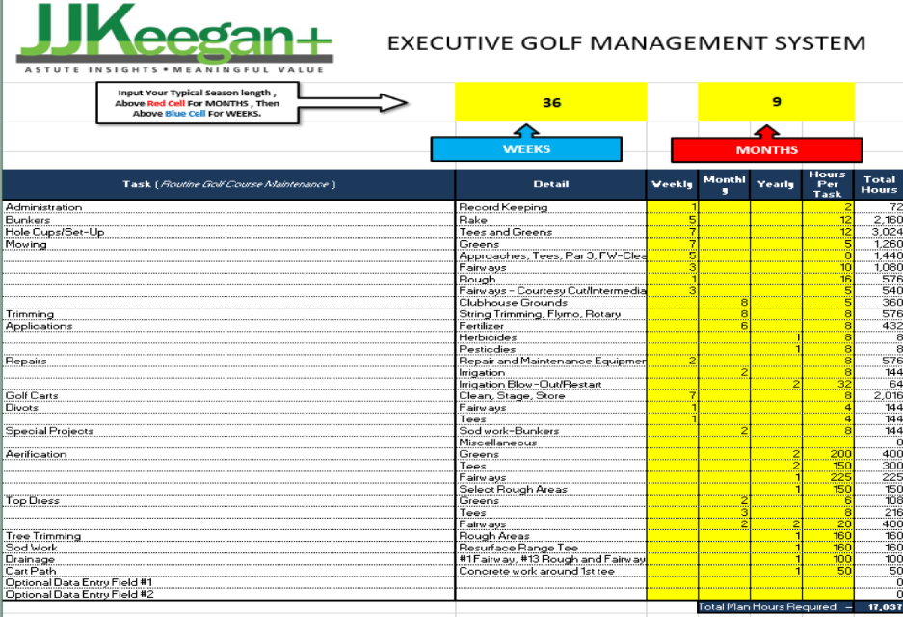

Slide 45
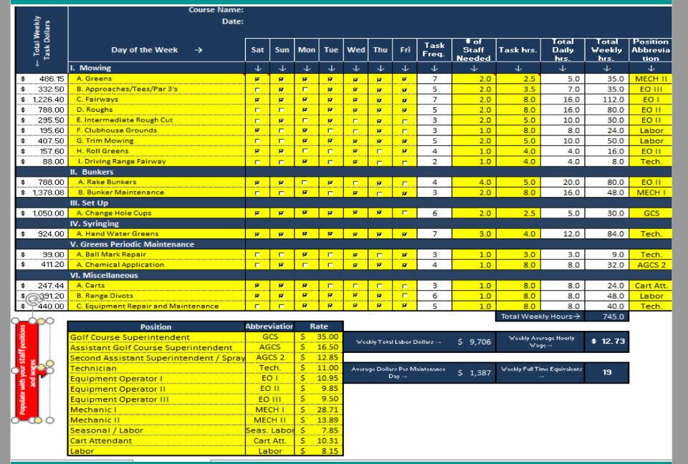

Slide 46
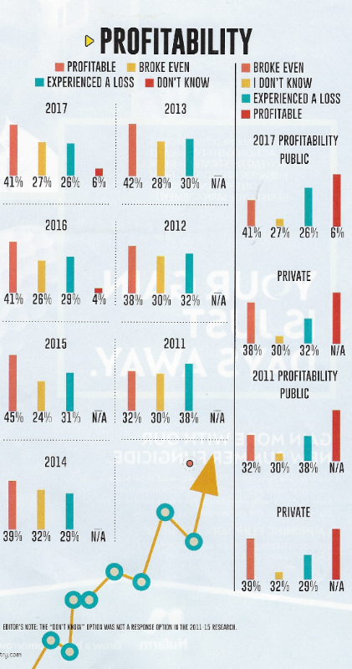

Slide 50
From 30,000 Feet

Slide 51
Notes:
Income has always been the best predictor of golf participation.

Slide 52
Notes:
Income has always been the best predictor of golf participation.

Slide 53
The Timeline of Decay & Management Practices
Pre 1990 Golf Course operations are profitable
_________
Self Manage
Lease
1991 – 1998
New golf courses added to local area, creating oversupply.
_________
Self Manage
1999 – 2003
Courses begin to lose money, general fund reserves tapped.
_________
Self Manage
Management Contracts
2004 – 2009
General reserves now depleted, requiring subsidy from the City.
_________
Self Manage
Management Contracts
2010 - 2018
Deferred capital expenditures become critical. _________
Self Manage
Management Contracts
Lease

Slide 54
We Create Walls to Protect our Vulnerability
Nationally - Supply Exceeds Demand. Competitive Forces control the prices
Supply
Rain, Snow, Sleet, Wind: Unpredictable Variability
Weather
Internet & Social Media of endless improvements and update mandates have changed in a marketplace of endless choices in an experience based economy
Technology
Lifestyle integration of home, work, commuting and a child centered focus on the wants, needs and desires have transferred to millennials seeking high intensity activities of short duration.
Time Crunched Culture
Water, Electricity, Fertilizer, Labor, Benefits
Expenses

Slide 55
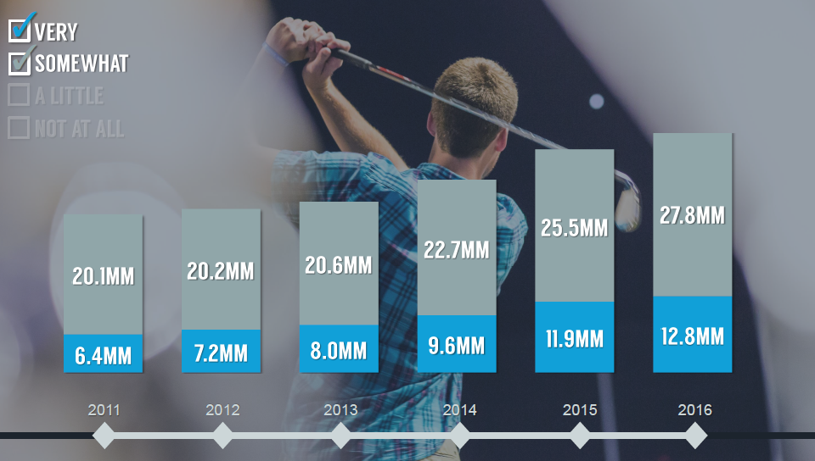
Notes:
Income has always been the best predictor of golf participation.

Slide 56
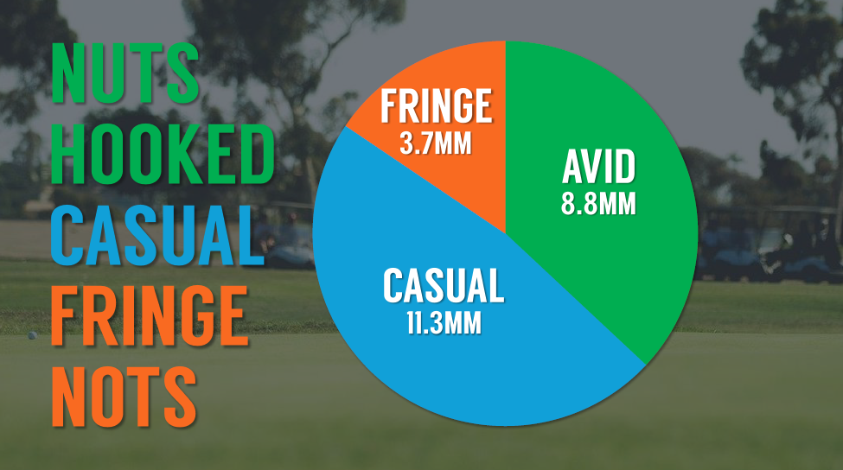
Notes:
Income has always been the best predictor of golf participation.

Slide 57
Notes:
Income has always been the best predictor of golf participation.

Slide 58
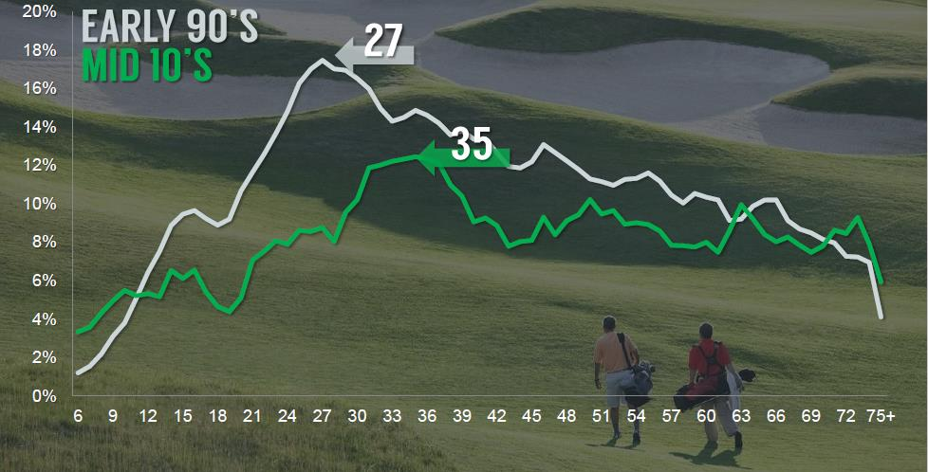
Notes:
Income has always been the best predictor of golf participation.

Slide 59
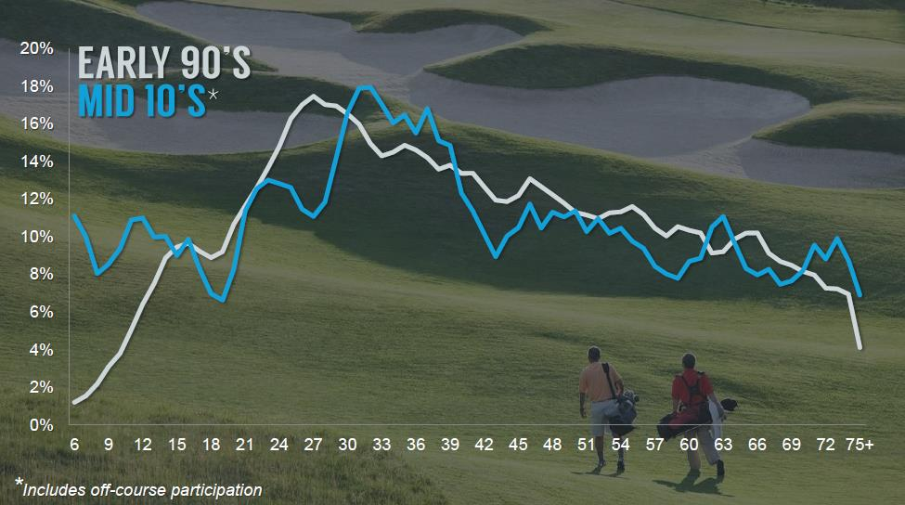
Notes:
Income has always been the best predictor of golf participation.

Slide 60
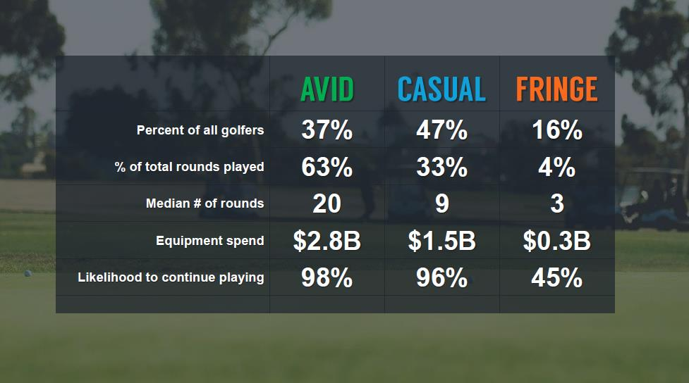
Notes:
Income has always been the best predictor of golf participation.

Slide 61
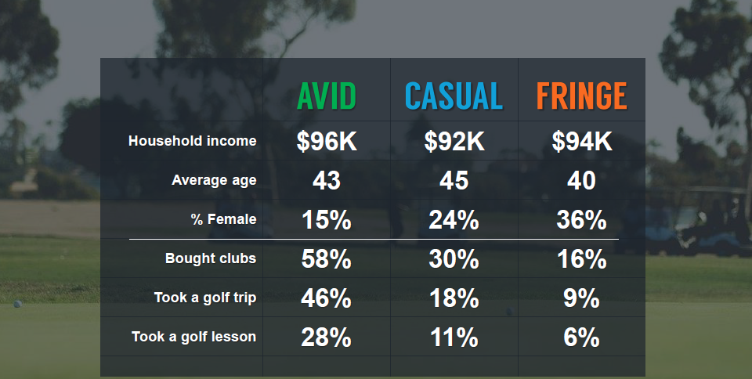
Notes:
Income has always been the best predictor of golf participation.

Slide 62
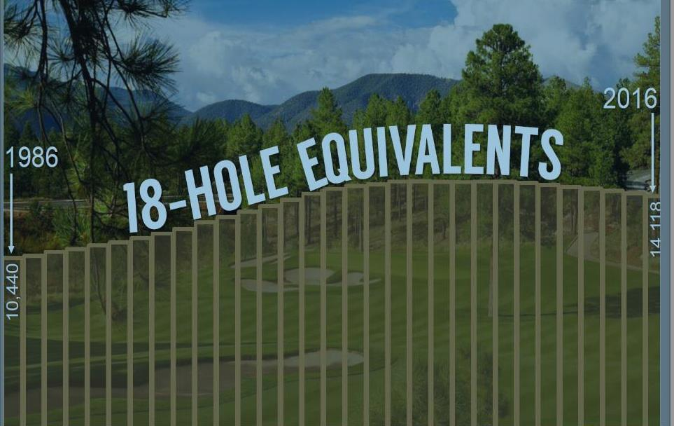
Notes:
Income has always been the best predictor of golf participation.

Slide 63
Notes:
Income has always been the best predictor of golf participation.

Slide 65
Notes:
Income has always been the best predictor of golf participation.

Slide 66
Notes:
Income has always been the best predictor of golf participation.

Slide 67
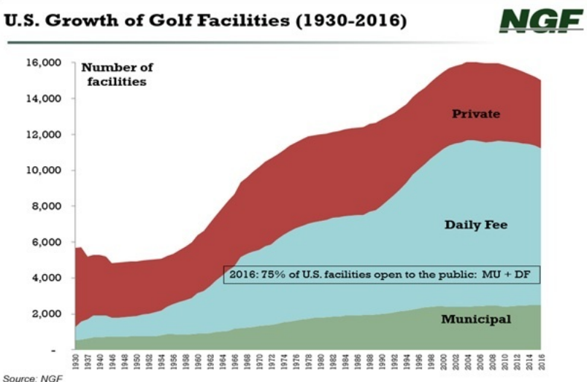
Notes:
Income has always been the best predictor of golf participation.

Slide 68
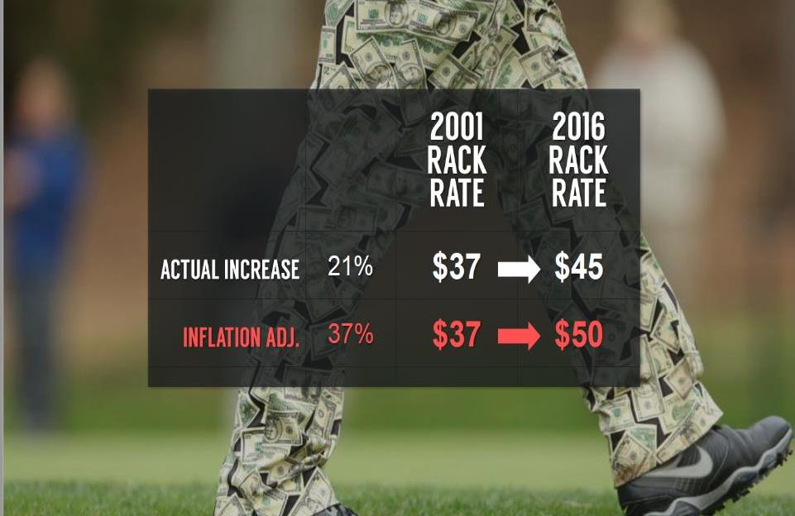
Notes:
Income has always been the best predictor of golf participation.

Slide 69
Notes:
Income has always been the best predictor of golf participation.

Slide 70
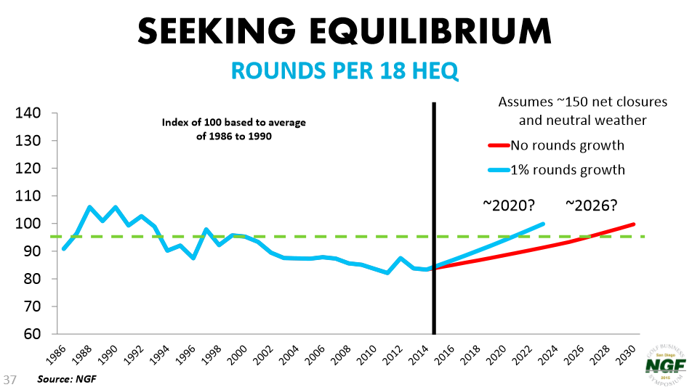
Notes:
Income has always been the best predictor of golf participation.

Slide 71
Financial Performance Municipal vs. Daily Fee Golf Courses
 | Platinum Top 10% | Gold Top 25% | Silver Median | Steel - Bottom 25%
MUNICIPALITIES
Rounds Played (210) | 48,636 | 38,500 | 28,000 | 22,634
Full‒Time Employees (141) | 15 | 9 | 6 | 5
Total Revenues (136) | $2,430,502 | 1,626,900 | 1,105,000 | 668,889
EBITDA (64) | $1,145,421 | $814,558 | $100,000 | $40,520
DAILY FEE
Rounds Played (227) | 42,500 | 34,500 | 26,000 | 19,000
Full‒Time Employees 246) | 30 | 16 | 6 | 5
Total Revenues (415) | $3,500,000 | $2,069,000 | $1,200,000 | $750,000
EBITDA (138) | $1,075,418 | $435,550 | $199,946 | $60,000
Source: PGA Performance Trak, 2016 compiled in 2017

Slide 72
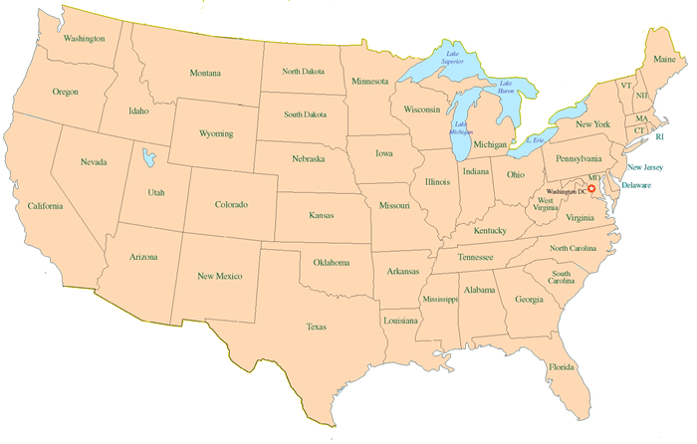
Payroll as a Percentage of Operating Revenue
National 54%
Northeast
53%
West
Midwest
55%
54%
Southwest
Southeast
54%
53%

Slide 73
Course Maintenance as a
Percentage of Available Cash
National 31% at Private Clubs
Municipal Golf Course Benchmark 40% - 45%
Northeast
32%
West
Midwest
36%
30%
Southwest
Southeast
30%
32%

Slide 74
Got Any
Start
Finish

Slide 75
Thank you
J. J. Keegan+
4406 Orofino Drive
Castle Rock, CO 80108
t 303-283-8880
c 303-596-4015
jjkeegan@jjkeegan.com

